Slide 1
DBMS Fundamentals
By - ANUPAMA

Slide 2

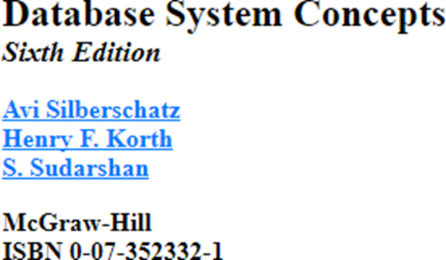
Course Textbook

Slide 3
DBMS
Database Management System
Contains information about particular enterprise
Set of program to access data
An environment that is both efficient and convenient to use.

Slide 4
What is database
It is a collection of interrelated data.
E.g.
Maintaining detail of an institute, which constitute the details of student, faculty, courses etc.

Slide 5
Database : Interrelated
DBMS – It is a system that provides an environment to handle database.
It must be easy and convenient to use.
It must contains some programs or interface to store data.
4 tasks of DBMS:
1. Store Data
2. Visualize data
3. Access(query) data
4. Update (manipulate) data.

Slide 6
Database Applications
Banking : transactions
Airlines: reservation, schedules
Universities : registration, grades
Sales : customer, products and purchases
Online Retailers: order tracking, customized recommendations
Manufacturing : production, inventory, orders, supply chain
Human Resources : employee records, salaries, tax deductions

Slide 7
University Database Example
Add new students, instructors and course
Assign grades to students
compute grade point
Do updation in fields of new students, instructors and course

Slide 8
File system
It is a large number of sequential files which can be written and read in a certain order and
Random access files where you can reach a particular point in the file to do certain access operation and certain manipulation operations .
Note : But, it was observed that the file systems to store data to manage data has lot of drawbacks.

Slide 9
Drawbacks of using file systems to store data
1. Data redundancy and inconsistency
Redundancy : Same data is available at multiple places in different forms.
Which results into various forms of inconsistency.
Example :
Student, teacher and course file is maintained at multiple places in different forms
And update the file at one place and forget to update the file at another place.

Slide 10
Drawbacks(cont…)
2. Difficulty in access data
Need to write a new program to carry out each new task
3. Data isolation
Multiple files and format
4. Integrity problems
Hard to add new constraints or change existing ones.
Whenever balance is updated, constraints should be check and then update the database.

Slide 11
Drawbacks (cont…)
Atomicity of updates
Failures may leave database in an inconsistent state with partial update carried out.
Example : Transfer of funds should be done full or none at all.

Slide 12
Drawbacks (cont…)
Concurrent access by multiple users
Concurrent access needed for performance
Uncontrolled access can lead to inconsistency
Example :
Railways reservation : booking of berth
Net banking : fund transfer

Slide 13
Drawbacks (cont…)
Security problems
Hard to provide user access to some, but not all data.
Durability
As the system crash file are lost.
No recovery methods
No backup techniques are used.
Note : Database systems offer solutions to all the file systems problems.

Slide 14
Advantages of DBMS over File Systems
1. It reduces the data redundancy and inconsistency problem.
Data Redundancy : same information is available at multiple places.
Data inconsistency : when multiple copies of file is available in system and one of the file is updated and the copied file is not updated.

Slide 15
2. Data Isolation
Excel file to be open in Linux, will not open correctly in windows.
But in case of database, every data is present in terms of bits.

Slide 16
3. data integrity
Semantic
In excel, if range is fixed for particular column
And enter values out of range will not result into error but if in case of database, while creating the schema range has been fixed.

Slide 17
4. Atomicity of Operations
E.g. Bank transfer case
From A to B -> credit
Then B : Credit
A: Debit
Done completely both or else none.

Slide 18
5. Concurrency
If multiple user are working on same file, then one person will update the file and then only next person can update the file.
However, in case of database
Multiple user can access the same database at a time.

Slide 19
6. Security
Authenticity
Various level of Access Control - > Attribute level privilege.
E.g. student can change the basic profile like address but not their CGPA/TGPA.

Slide 20
Level of Abstraction
Physical level: describes how a record (e.g., instructor) is stored
Logical level: describes data stored in database, and the relationships among the data
type instructor = record
ID : string;
name : string;
dept_name : string;
salary : integer end;
View level/Conceptual level: application programs hide details of data types
Views can also hide information (such as an employee’s salary) for security purposes

Slide 21
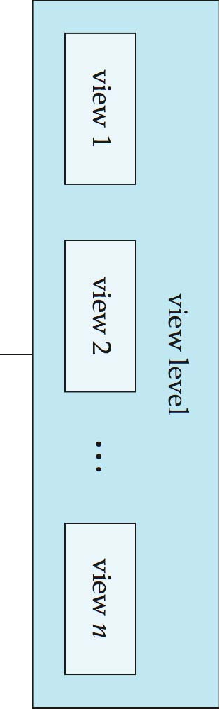
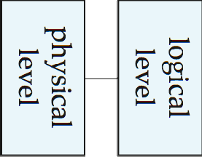
View of Data
An architecture for a database systems

Slide 22
Schema and Instance
Similar to types and variables in programming languages
Schema
Logical Schema – the overall logical structure of the database
Analogous to type information of a variable in a program
Example: The database consists of information about a set of customers and accounts in a bank and the relationship between them
Customer Schema
Account Schema
Physical Schema– the overall physical structure of the database
Name | Customer ID | Account # | Aadhaar ID | Mobile #
Account # | Account Type | Interest Rate | Min. Bal. | Balance

Slide 23
Schema and Instance
Instance
The actual content of the database at a particular point in time
Analogous to the value of a variable
Customer Instance
Customer Instance
Account Instance
Name | Customer ID | Account # | Aadhaar ID | Mobile #
Pavan Laha | 6728 | 917322 | 182719289372 | 9830100291
Lata Kala | 8912 | 827183 | 918291204829 | 7189203928
Nand Prabhu | 6617 | 372912 | 127837291021 | 8892021892
Account # | Account Type | Interest Rate | Min. Bal. | Balance
917322 | Savings | 4.0% | 5000 | 7812
372912 | Current | 0.0% | 0 | 291820
827183 | Term Deposit | 6.75% | 10000 | 100000

Slide 24
Schema and Instance
Physical Data Independence – the ability to modify the physical schema without changing the logical schema
Applications depend on the logical schema
In general, the interfaces between the various levels and components should be well defined so that changes in some parts do not seriously influence others.

Slide 25
DDL and DML
DDL ( Data Definition Language)
Specification notation for defining the database schema
Example:
create table instructor (
Id char(5),
Name varchar(20),
Dept_name varchar(20),
Salary number(8,2)
)

Slide 26
DDL (Cont…)
DDL compiler generates a set of table templates stored in a data dictionary
Data dictionary contains metadata (i.e., data about data)
Database schema
Integrity constraints
 Primary key (ID uniquely identifies instructors)
Authorization
 Who can access what

Slide 27
DML
Language for accessing and manipulating the data organized by the appropriate data model
DML also known as query language

Slide 28
SQL
The most widely used commercial language
SQL is NOT a Turing machine equivalent language
Cannot be used to solve all problems that a C program, for example, can solve
To be able to compute complex functions SQL is usually embedded in some higher-level language
Application programs generally access databases through one of
Language extensions to allow embedded SQL
Application program interface (e.g., ODBC/JDBC) which allow SQL queries to be sent to a database

Slide 29
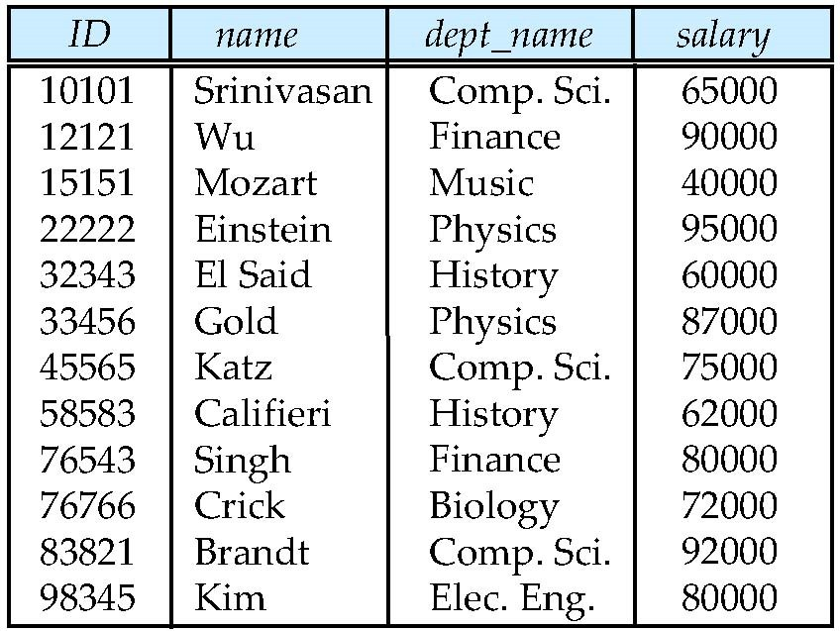
Examples of a Relation
attributes (or columns)
tuples (or rows)

Slide 30
Attributes
The set of allowed values for each attribute is called the domain of the attribute
Roll #: Alphanumeric string
First Name, Last Name: Alpha String
DoB: Date
Passport #: String (Letter followed by 7 digits) – nullable
Aadhaar #: 12-digit number
Department: Alpha String
Attribute values are (normally) required to be atomic; that is, indivisible
The special value null is a member of every domain. Indicated that the value is “unknown”
The null value causes complications in the definition of many operations
Roll # | First Name | Last Name | DoB | Passport # | Aadhaar # | Department
15CS10026 | Lalit | Dubey | 27-Mar-1997 | L4032464 | 1728-6174-9239 | Computer
16EE30029 | Jatin | Chopra | 17-Nov-1996 | null | 3917-1836-3816 | Electrical

Slide 31
Relation Schema and Instance
A₁, A₂, …, A_{n} are attributes
R = (A₁, A₂, …, A_{n} ) is a relation schema
Example:
instructor = (ID, name, dept_name, salary)
Formally, given sets D₁, D₂, …. D_{n} a relation r is a subset of
D₁ x D₂ x … x D_{n}
Thus, a relation is a set of n-tuples (a₁, a₂, …, a_{n}) where each a_{i} ∈ D_{i}
The current values (relation instance) of a relation are specified by a table
An element t of r is a tuple, represented by a row in a table

Slide 32
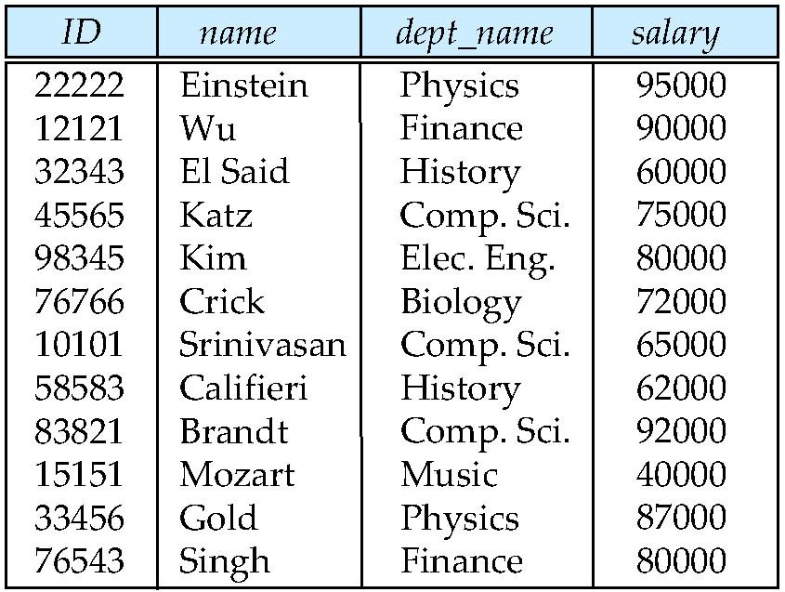
Relations are Unordered
Order of tuples is irrelevant (tuples may be stored in an arbitrary order)
Example: instructor relation with unordered tuples

Slide 33
Database Design
The process of designing the general structure of the database:
Logical Design – Deciding on the database schema. Database design requires that we find a “good” collection of relation schemas.
Business decision
What attributes should we record in the database?
Computer Science decision
What relation schemas should we have and how should the attributes be distributed among the various relation schemas?
Physical Design – Deciding on the physical layout of the database

Slide 34
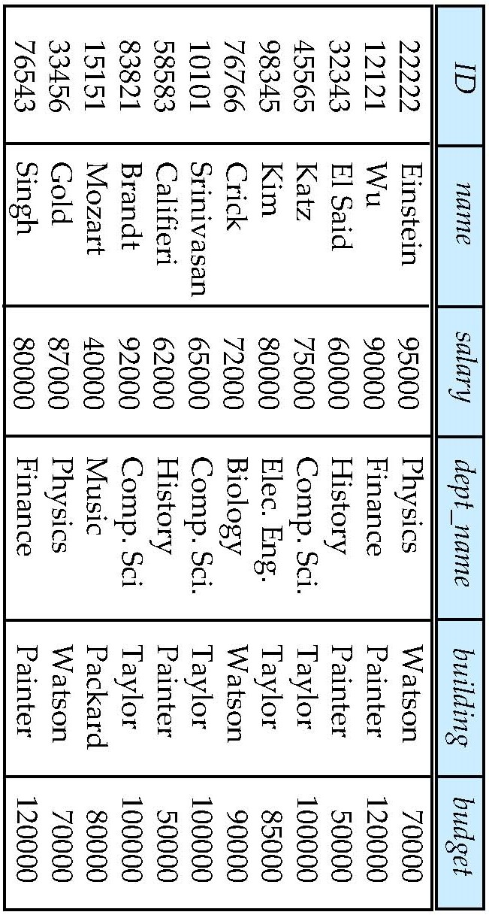
Database Design(Cont…)
Is there any problem with this relation?

Slide 35
Design Approaches
Need to come up with a methodology to ensure that each of the relations in the database is “good”
Two ways of doing so:
Entity Relationship Model
 Models an enterprise as a collection of entities and
relationships
 Represented diagrammatically by an entity-relationship diagram:
Normalization Theory
 Formalize what designs are bad, and test for them

Slide 36
Data Models
A collection of tools for describing
Data
Data relationships
Data semantics
Data constraints
Relational model
Entity-Relationship data model (mainly for database design)
Object-based data models (Object-oriented and Object-relational)
Semi-structured data model (XML)
Other older models:
Network model
Hierarchical model

Slide 37
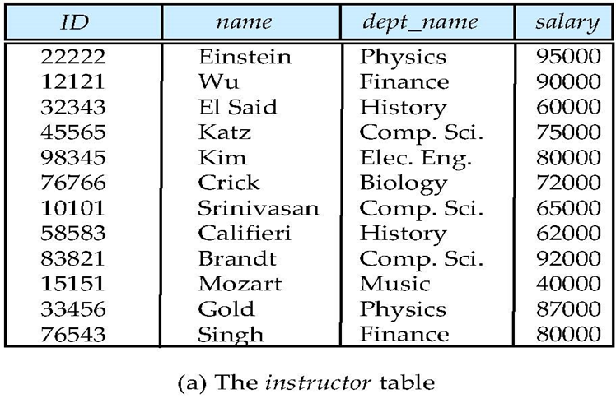
Relational Model
All the data is stored in various tables
Example of tabular data in the relational model.
Columns
Rows

Slide 38
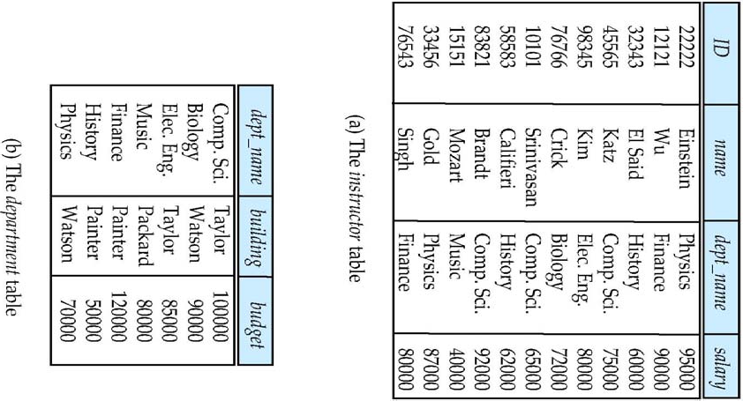
A sample Relational Model

Slide 39
Object Relational Data Models
Relational model: flat, “atomic” values
Object Relational Data Models
Extend the relational data model by including object orientation and constructs to deal with added data types
Allow attributes of tuples to have complex types, including non- atomic values such as nested relations
Preserve relational foundations, in particular the declarative access to data, while extending modeling power
Provide upward compatibility with existing relational languages

Slide 40
XML
Extensible Markup Language
Defined by the WWW Consortium (W3C)
Originally intended as a document markup language not a database language
The ability to specify new tags, and to create nested tag structures made XML a great way to exchange data, not just documents
XML has become the basis for all new generation data interchange formats
A wide variety of tools is available for parsing, browsing and querying XML documents/data

Slide 41
Database Engine
Storage manager
Query processing
Transaction manager

Slide 42
Storage Management
Storage manager is a program module that provides the interface between the low-level data stored in the database and the application programs and queries submitted to the system.
The storage manager is responsible to the following tasks:
Interaction with the OS file manager
Efficient storing, retrieving and updating of data
Issues:
Storage access
File organization
Indexing and hashing

Slide 43
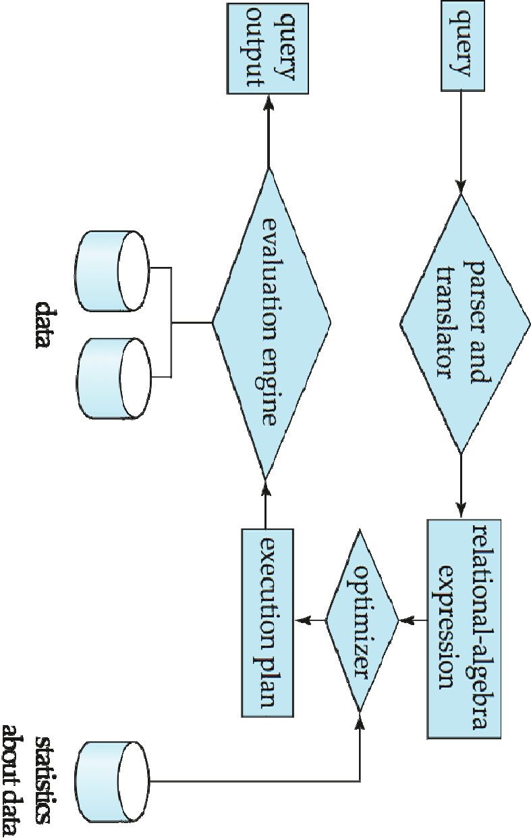
Query Processing
Parsing and translation
Optimization
Evaluation

Slide 44
Query Processing (Cont…)
Alternative ways of evaluating a given query
Equivalent expressions
Different algorithms for each operation
Cost difference between a good and a bad way of evaluating a query can be enormous
Need to estimate the cost of operations
Depends critically on statistical information about relations which the database must maintain
Need to estimate statistics for intermediate results to compute cost of complex expressions

Slide 45
Transaction Management
What if the system fails?
What if more than one user is concurrently updating the same data?
A transaction is a collection of operations that performs a single logical function in a database application
Transaction-management component ensures that the database remains in a consistent (correct) state despite system failures (e.g., power failures and operating system crashes) and transaction failures.
Concurrency-control manager controls the interaction among the concurrent transactions, to ensure the consistency of the database.

Slide 46
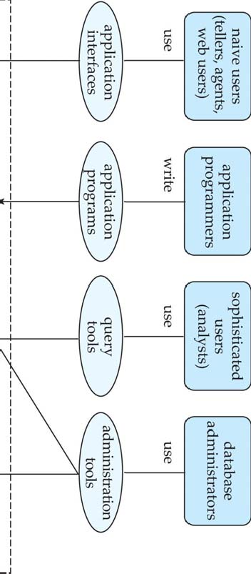
DATABASE USERS AND ADMINISTRATOR
Database

Slide 47
DATABASE INTERNALS AND ARCHITECTURE

Slide 48
Database Architecture
The architecture of a database systems is greatly influenced by
the underlying computer system on which the database is running:
Centralized
Client-server
Parallel (multi-processor)
Distributed

Slide 49
History of DBMS
1950s and early 1960s:
Data processing using magnetic tapes for storage
Tapes provided only sequential access
Punched cards for input
Late 1960s and 1970s:
Hard disks allowed direct access to data
Network and hierarchical data models in widespread use
Ted Codd defines the relational data model
Would win the ACM Turing Award for this work
IBM Research begins System R prototype
UC Berkeley begins Ingres prototype
High-performance (for the era) transaction processing

Slide 50
History (cont…)
1980s:
Research relational prototypes evolve into commercial systems
SQL becomes industrial standard
Parallel and distributed database systems
Object-oriented database systems
1990s:
Large decision support and data-mining applications
Large multi-terabyte data warehouses
Emergence of Web commerce
Early 2000s:
XML and XQuery standards
Automated database administration
Later 2000s:
Giant data storage systems
Google BigTable, Yahoo PNuts, Amazon, ..

Slide 51
Keys
Let K ⊆ R
K is a superkey of R if values for K are sufficient to identify a unique tuple of each possible relation r(R)
Example: {ID} and {ID,name} are both superkeys of instructor
Superkey K is a candidate key if K is minimal
Example: {ID} is a candidate key for Instructor
One of the candidate keys is selected to be the primary key

Slide 52
Keys
Super Key: Roll #, {Roll #, DoB}
Candidate Keys: Roll #, {First Name, Last Name}, Passport #, Aadhaar #
Passport # cannot be a key. Why?
Null values are allowed for Passport # (a student may not have a passport)
Roll # | First Name | Last Name | DoB | Passport # | Aadhaar # | Department
15CS10026 | Lalit | Dubey | 27-Mar-1997 | L4032464 | 1728-6174-9239 | Computer
16EE30029 | Jatin | Chopra | 17-Nov-1996 | null | 3917-1836-3816 | Electrical
15EC10016 | Smriti | Mongra | 23-Dec-1996 | G5432849 | 2045-9271-0914 | Electronics
16CE10038 | Dipti | Dutta | 02-Feb-1997 | null | 5719-1948-2918 | Civil
15CS30021 | Ramdin | Minz | 10-Jan-1997 | X8811623 | 4928-4927-5924 | Computer

Slide 53
Keys
Primary Key: Roll #
Secondary / Alternate Key: {First Name, Last Name}, Aadhaar #
Simple key: Consists of a single attribute
Composite Key: {First Name, Last Name}
Roll # | First Name | Last Name | DoB | Passport # | Aadhaar # | Department
15CS10026 | Lalit | Dubey | 27-Mar-1997 | L4032464 | 1728-6174-9239 | Computer
16EE30029 | Jatin | Chopra | 17-Nov-1996 | null | 3917-1836-3816 | Electrical
15EC10016 | Smriti | Mongra | 23-Dec-1996 | G5432849 | 2045-9271-0914 | Electronics
16CE10038 | Dipti | Dutta | 02-Feb-1997 | null | 5719-1948-2918 | Civil
15CS30021 | Ramdin | Minz | 10-Jan-1997 | X8811623 | 4928-4927-5924 | Computer

Slide 54
Keys
Foreign key constraint: Value in one relation must appear in another
Referencing relation
Enrolment: Foreign Keys – Roll #, Course #
Referenced relation
Students, Courses
A composite key consists of more than one attribute to uniquely identify an entity occurrence
Each attribute, which makes up the key, is a simple key in its own right.
{Roll#, Course#)
Students
Roll # | First Name | Last Name | DoB | Passport # | Aadhaar # | Department

Slide 55
Courses
Enrollment
Course # | Course Name | Credits | L-T-P | Department
Roll # | Course # | Instructor ID

Slide 56
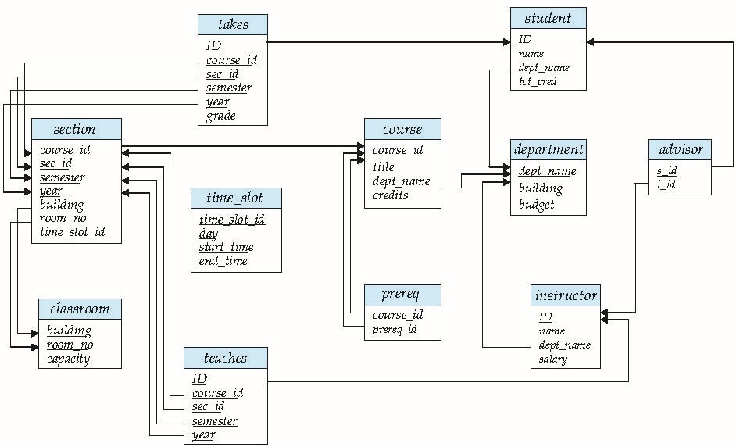
Schema Diagram for University Database

Slide 57
Relational Algebra
Two classes of languages
Pure – used for proving properties about computational power and for optimization
 Relational Algebra
 Tuple relational calculus
 Domain relational calculus
Commercial – used in commercial systems
 SQL is the most widely used commercial language

Slide 58
Relational Query Language
Procedural vs. Non-procedural or Declarative Paradigms
Procedural programming requires that the programmer tell the computer what to do
That is, how to get the output for the range of required inputs
The programmer must know an appropriate algorithm
Declarative programming requires a more descriptive style
The programmer must know what relationships hold between various entities
Example: Square root of n
Procedural
Guess x₀ (close to root of n)
2. i ← 0
3. x_{i+1} ← (x_{i} + n / x_{i}) / 2
4. Repeat Step 2 if | x_{i+1 –} x_{i} | > delta
Declarative
Root of n is m such that m² = n

Slide 59
Relational Query Language
“Pure” languages:
Relational algebra
Tuple relational calculus
Domain relational calculus
The above 3 pure languages are equivalent in computing power
Consists of 6 basic operations

Slide 60
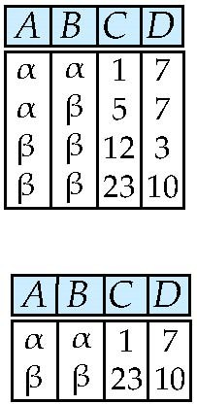
Relational Operators
Select Operation – selection of rows (tuples)
Relation r
^{σ}A=B ^ D > 5 ^{(r)}

Slide 61
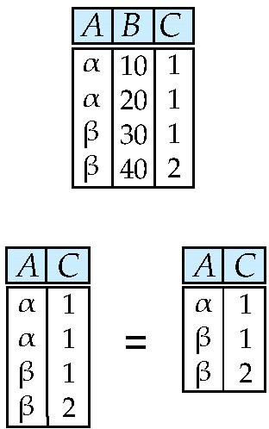
Project Operation – selection of columns (Attributes)
Relation r:
∏_{A,C} (r)

Slide 62
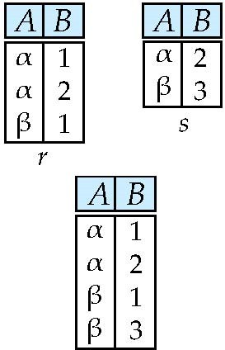
Union of two relations
Relations r, s:
r ∪ s:

Slide 63
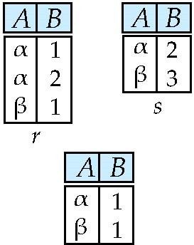
Set difference of two relations
Relations r, s:
r – s:

Slide 64
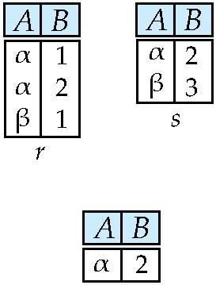
Set intersection of two relations
Relation r, s:
r ∩ s

Slide 65
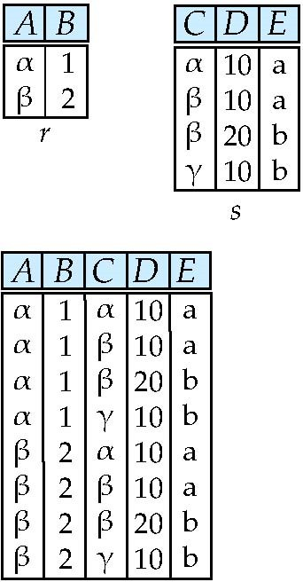
Joining two relations – Cartesian Product
Relations r, s:
r x s:

Slide 66
Cartesian product – naming issue
Relations r, s:
r x s:

Slide 67
Renaming a table
Allows us to refer to a relation, (say E) by more than one name.
ρ _{x} (E)
returns the expression
E under the name X
Relations r
r x ρ _{s} (r)
r.A | r.B | s.A | s.B
α | 1 | α | 1
α | 1 | β | 2
β | 2 | α | 1
β | 2 | β | 2

Slide 68
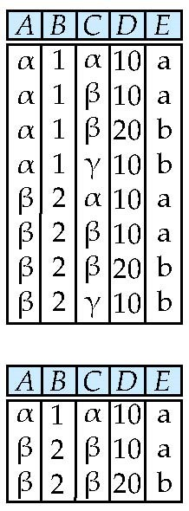
Composition of opertions
Can build expressions using multiple operations
Example: σ_{A=C} (r x s)
r x s
σ_{A=C} (r x s)

Slide 69
Joining two relations – Natural Join
Let r and s be relations on schemas R and S respectively. Then, the “natural join” of relations R and S is a relation on schema R  S obtained as follows:
Consider each pair of tuples t_{r} from r and t_{s} from s.
If t_{r} and t_{s} have the same value on each of the attributes in R  S, add a tuple t to the result, where
 t has the same value as t_{r} on r
 t has the same value as t_{s} on s

Slide 70
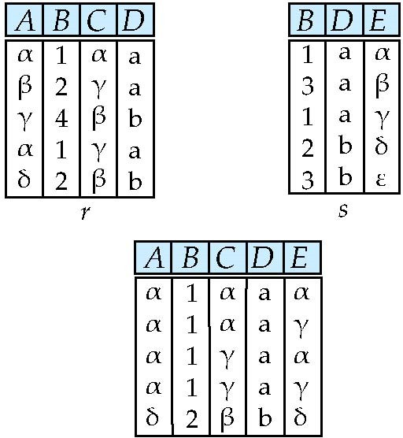
Natural Join - Example
Relations r, s:
Natural Join
n r s
∏ A, r.B, C, r.D, E ^{(σ} r.B = s.B ˄ r.D = s.D ^{(r x s)))}

Slide 71
Aggregation Operators
Can we compute:
SUM
AVG
MAX
MIN

Slide 72
Notes about Relational Languages
Each Query input is a table (or set of tables)
Each query output is a table
All data in the output table appears in one of the input tables
Relational Algebra is not Turning complete

Slide 73
Summary of Relational Algebra Operators
Symbol (Name)
Example of Use
σ
(Selection)
σ _{salary > = 85000} (instructor)
Return rows of the input relation that satisfy the predicate.
Π
(Projection)
Π _{ID, salary} (instructor)
Output specified attributes from all rows of the input relation. Remove duplicate tuples from the output.
(Cartesian Product)
instructor x department
Output pairs of rows from the two input relations that have the same value on all attributes that have the same name.
(Union)
Π _{name} (instructor) ∪ Π _{name} (student)
Output the union of tuples from the two input relations.
(Set Difference)
Π _{name} (instructor) ‐‐ Π _{name} (student)
Output the set difference of tuples from the two input relations.
⋈
(Natural Join)
instructor ⋈ department
Output pairs of rows from the two input relations that have the same value on all attributes that have the same name.

